Slide 1

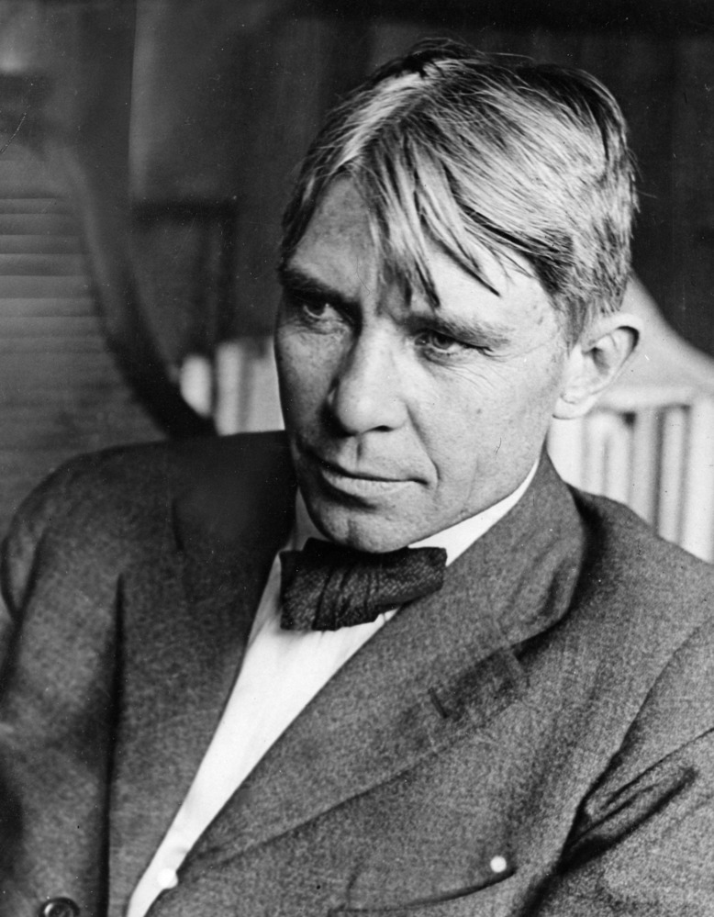
"Poet of the People“
Carl Sandburg provided a popular voice for the American people of the twentieth century and still speaks to us through his words, activism, music and the beauty and serenity of Carl Sandburg Home National Historic Site.
www.nps.gov/carl

Slide 2
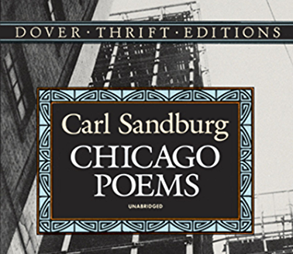
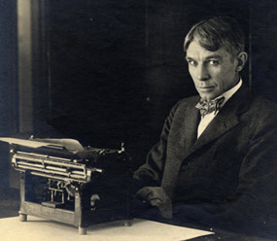
Persuasion Poems
Carl Sandburg was a very passionate man. He had his opinions about what he believed was right and what he believed was wrong about society. He often used poetry to voice his opinion about such things. In fact, his very first book of published poetry, “Chicago Poems,” was page after page of what he thought about the city he loved.
Tasks:
Click this link https://www.youtube.com/watch?v=MsGpmbwiuaM to watch a video on theme and tone in poetry.
Beginning with slide 3, read each poem aloud. Answer questions about each poem and submit to your teacher.

Slide 3
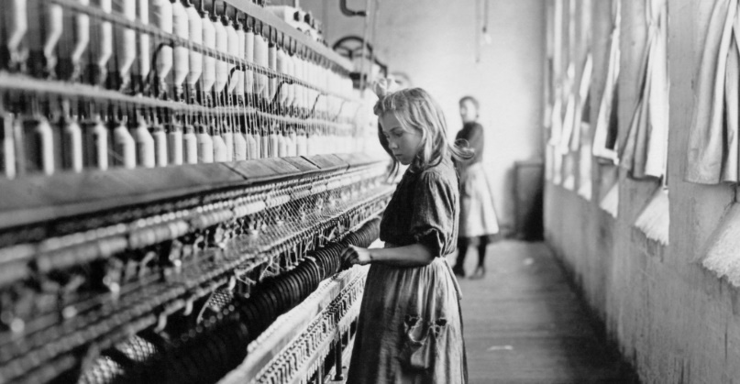
Mill-Doors by Carl Sandburg
Write your response here…
You never come back.
I say good-bye when I see you going in the doors,
The hopeless open doors that call and wait
And take you then for – how many cents a day?
How many cents for the sleepy eyes and fingers?
I say good-bye because I know they tap your wrists,
In the dark, in the silence, day-by-day,
And all the blood of you drop by drop,
And you are old before you are young.
You never come back.
Find one example of figurative language in the poem (e.g. hyperbole, metaphor, simile, imagery, understatement, alliteration).
Explain why you think Sandburg used this literary device in the poem. What does it “add” to the poem? Does it create the mood or reveal the tone or theme in some way?

Slide 4
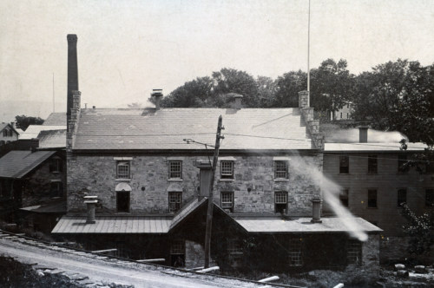
Anna Imroth
by Carl Sandburg
Write your response here…
Cross the hands over the breast here—so.
Straighten the legs a little more –so
And call for the wagon to come and take her home.
Her mother will cry some and so will her sisters and brothers.
But all of the others got down and they are safe
and this is the only one of the factory girls who
wasn’t lucky in making the jump
when the fire broke.
It is the hand of God and the lack of fire escapes.
What issue was Carl Sandburg addressing in this poem?
How can you paraphrase this poem into 1-2 concise sentences that helps to make the issue clear to others?

Slide 5
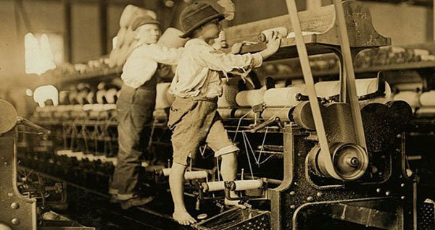
They Will Say
by Carl Sandburg
Write your response here…
Of my city the worst that men will ever say is this:
You took little children away from the sun and the dew,
And the glimmers that played in the grass under the great sky,
And the reckless rain; you put them between walls
To work, broken and smothered, for bread and wages,
To eat dust in their throats and die empty-hearted
For a little handful of pay on a few Saturday nights.
How is personification used in this poem?
Explain why you think Sandburg used this literary device in the poem. What does it “add” to the poem? Does it create the mood or reveal the tone or theme in some way?

Slide 6
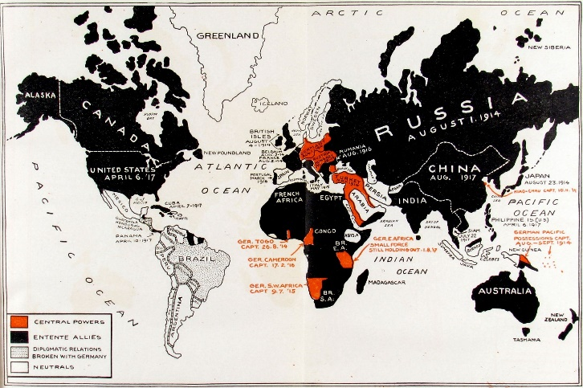
Buttons
by Carl Sandburg
Write your response here…
I have been watching the war map slammed up for advertising in
Front of the newspaper office.
Buttons – red and yellow buttons – blue and black buttons – are
Shoved back and forth across the map.
A laughing young man, sunny with freckles,
Climbs a ladder, yells a joke to somebody in the crowd,
And then fixes a yellow button one inch west
And follows the yellow button with a black button one inch west.
(Ten thousand men and boys twist on their bodies in a red soak
along a river edge,
Gasping of wounds, calling for water, some rattling death in their
throats.)
Who would guess what it cost to move two buttons one inch on the
war map here in front of the newspaper office where the
freckle-faced young man is laughing at us.
What is the social issue being addressed in the poem?
How is the issue the same now?
How has it changed since Sandburg’s time?

